Slide 1
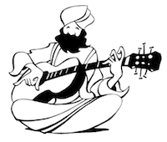
Dragon Taming for Smart People
Meditation & Creativity
Dada Nabhaniilananda
The Monk Dude
Notes:
Why do I wear orange?
Today I’m going to show you three things.
How you can tap into your inner source of creativity and intuition by withdrawing your mind from the world.
How you can cultivate your inner wisdom and intuition through concentration
And how you can connect to the source of love within you through music and mantra.
But first I’d just like to know how many of you meditate already?
How many of you have tried meditation?
How many meditate every day.
How many of you think you should meditate every day, but don’t?
How many of you listen to music by a rock star who used to meditate?

Slide 2
Where do ideas come from?
Notes:
I’ve wondered about this since I was really young. I was into composing music and art and creative writing, and I was fascinated by the Greek idea of the muses - invisible entities that inspire us when they feel so inclined. And sometimes they come, and sometimes they don’t. That’s how it felt to me. Sometimes the ideas come in a flow, sometimes they don’t.

Slide 3
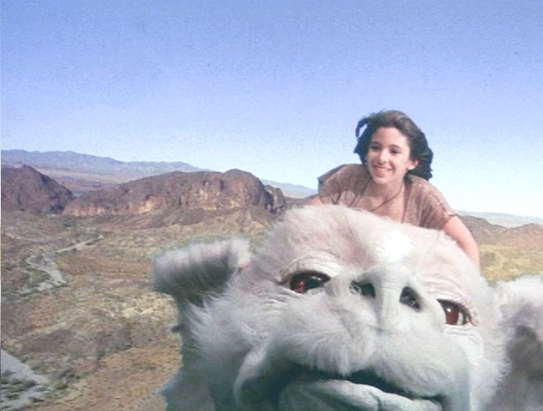
Artistic temperament sometimes seems a battleground, a dark angel of destruction and a bright angel of creativity, wrestling.
Madeleine L'Engle

Slide 4
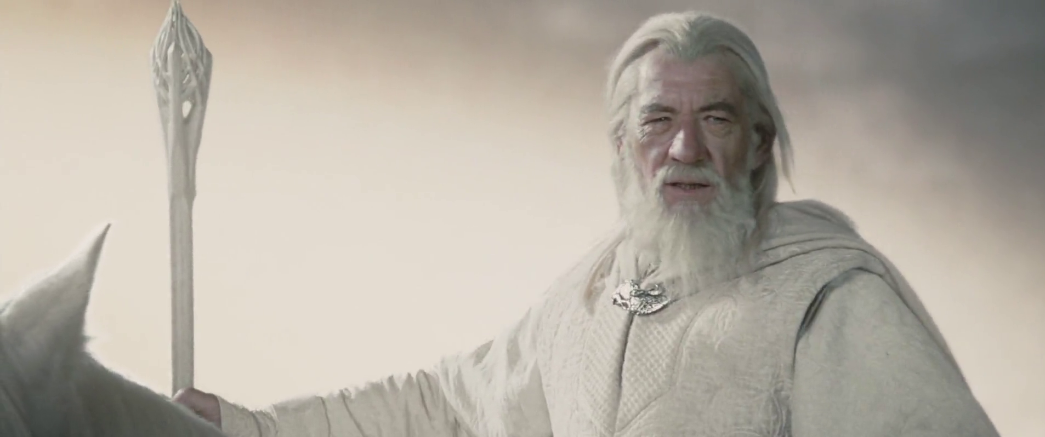
Notes:
When I was a ten years old I wanted to be a wizard. I dreamed of being wise and strong and kind, like Gandalf who saved the world from the evil Lord of the Rings. So you can imagine my excitement when my older brother, Christian, revealed that he was already a wizard. This seemed like a golden opportunity to advance my future career, so I applied to be his apprentice.
“You cannot possibly become a wizard like me,” he said, "for you are afraid of the dark. If you want to become my disciple you must undergo a terrible test. You have to walk down into the heart of the forest alone at midnight, wait there for one minute and just listen."
This seemed impossible. I was terrified of the dark and afraid to enter the forest alone even in daylight. Not because I was a coward - it was because I was convinced that our garden was infested with tigers.
But I yearned to become a wizard so I mustered my courage and all alone on a windy night I crept out of our front door and down the long curving path towards the forest. I sensed the tigers shadowing me, tongues lolling, ready to pounce should I falter. Each step was an effort of will but I fought down my terror and came at last to the heart of the woods where I waited and listened. And I felt calm despite my fear, and strong despite my youth, and a great joy welled up in me, for I was to become a Wizard.
As I grew older I developed new interests. I'd been studying classical music since I was four, but it wasn't until I heard Led Zeppelin perform Stairway to Heaven live for the first time that I knew what I wanted to be. Now I had a much more realistic ambition.

Slide 5
Notes:
I was going to be a Rockstar
Then in 1975, when I was 19, I had an extra-ordinary spiritual experience that changed everything.
In that moment I understood that the purpose of human existence is to become one with the source of infinite love within us.
I felt called to walk the spiritual path as a Yogi and master my mind through meditation.
My new goal was to serve, teach, and guide others on the path to happiness.

Slide 6
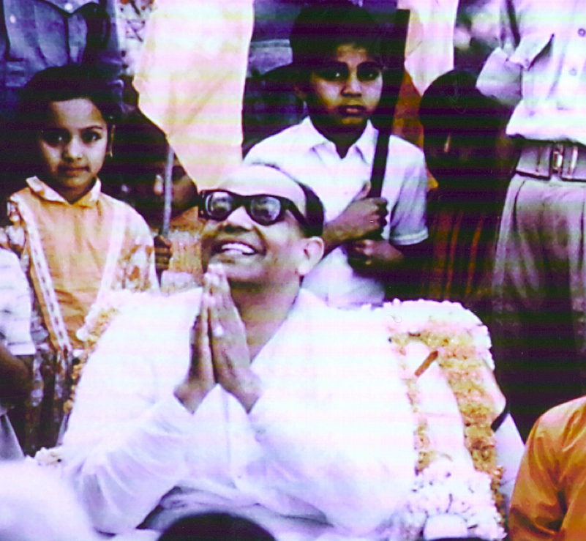

Slide 7
Notes:
How would it be if you could just switch it on at will? If you could go into whatever state it is where ideas just flow, and inspiration is right there - so you can reach out and pluck the next fresh idea that leads to whatever follows Google Glass, brilliant new world changing idea like a ripe fruit?
I began practicing meditation because wanted to become enlightened and realize the truth of existence. I have to say, this particular goal has turned out to be a lot harder than I expected.
In any event, when I started out, I had no idea that meditation had anything to do with Creativity.
But I pretty soon did. The first thing I noticed within weeks of beginning to meditate regularly was that I started getting amazing ideas for my poetry and music - it was as though I’d turned on this invisible inspiration tap. It was very powerful.
Then one afternoon I was practicing the first movement of Beethoven’s first Piano Sonata, and as I played the seven closing chords, I was overwhelmed by the sheer beauty of the music. I became ecstatic - it was overwhelming and transporting, as though for a moment I was Beethoven, feeling what he felt when he composed the music long ago.

Slide 8
The Intuitional Science of Yoga
Notes:
This meditation stuff seemed to be doing things to my mind that I had not anticipated. Good things!
As I learned more about the meditation process and the different practices came come under the umbrella of yoga and meditation, I realized that the yogis of old had this creativity thing figured out ages ago. They had a whole model of the mind describing three different levels of intuition, and prescribing techniques to tap into each one of them. This whole system is sometimes known as Intuitional Science, which is what I teach and coach people in.
Today I’m going to give you as much as I can of that in the time we have together.

Slide 9
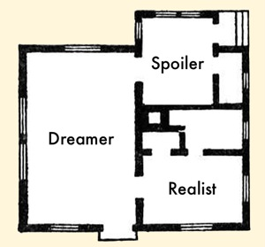
Creative external environments
Notes:
Creativity. This is a huge subject, and is a hot topic in the corporate world these days. Everyone is looking for the next big idea that solves a critical problem, and everyone wants to know how to switch on the idea factory inside our minds. In the information era, creativity is bankable.
IBM Study - 2010
Why is creativity one of the most sought after commodities in Business today? In May 2010, IBM released a survey “of more than 1,500 Chief Executive Officers from 60 countries and 33 industries worldwide, chief executives believe that — more than rigor, management discipline, integrity or even vision — successfully navigating an increasing complex world will require creativity.” (IBM press release, www.ibm.com)
Companies like Disney and 3M and Google and others invest a lot of resources trying to forge a company culture that fosters the cross fertilization of ideas and nurtures innovation. And sure enough, sometimes we get amazing, unforeseeable outcomes like Google Glass and the Google flying car. Oh sorry - I meant to say self-steering car. I know, the flying car is still secret. Don’t worry, my lips are sealed.
Setting up the right kind of external environment full of dinosaurs and space ships and beach volley ball courts are all very effective and are a critical part of solving the creativity puzzle. But that is not what I’m going to talk about today. You already know about that.

Slide 10
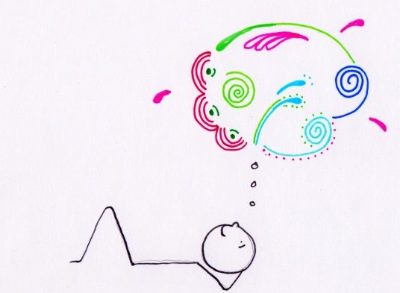
Creative Internal Environment
Notes:
Today I’m going to introduce you to some tools and techniques designed for tapping directly into our internal source of creativity. Tools that work in a prison cell, or a play pen - they are not dependent on any particular external environment. So we are looking at the psychological process of creativity, and how it relates to meditation.
Creative time line - birthing process: products - Google product or Mona Lisa, creative culture - e.g. Disney and Google. All starts in the mind - dreamer imagination.
Every idea comes from within someone’s mind. So we are going to learn about how to go within.

Slide 11
The Monk Dude’s Famous
Creativity
Test
Notes:
The Monk Dude’s Creativity Test
I like to bust one myth for you.
Who amongst you thinks they are creative?
Earlier, I asked you who was once a child. I’m pretty sure you all were. Which means you are all creative.
Creativity is not a talent. It is a state of being. There is no correlation between IQ and creativity.
It is an ability to get into that ‘play’ mode that we all have within us.
It is suppressed by too much analytical, Thinkaholic type, thinking.

Slide 12
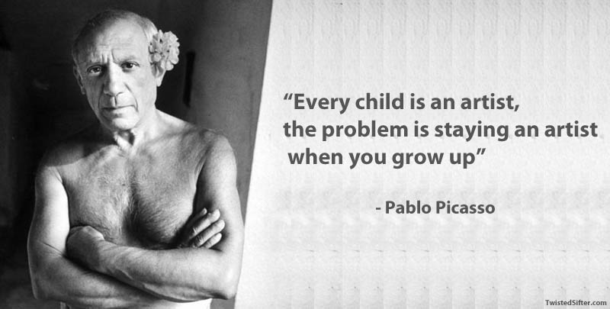

Slide 13
Yoga Psychology - Layers of Mind
Awareness
Intuition
Wisdom
Creativity & Personality
Subconscious
Memory and Reason
Conscious
Sensing, Desiring, Acting
Physical Body
Notes:
This is a simplified explanation of the model of the mind according to the psychology of yoga - the most ancient school of psychology, and philosophy, in the world.
The mind is layered. This is an idea shared of course by western psychologists. And what lies beneath the surface, what we call the sub-conscious mind, is much greater than what is visible - which we think of as the conscious mind. Like an island - the hidden part is by far the greater portion. Hence the terms conscious, subconscious and unconscious mind coined by Freud and Jung.
But in yoga psychology, what Jung referred to as the unconscious, or sometimes the collective unconscious, is further subdivided into three layers. And for the purposes of simplicity I’ve labelled these according to their primary functions, rather than with their more accurate sanskrta names.
Sensory - Kamamaya Kosa. Desire to go towards warmth, away from cold.
Intellectual - memory and reasoning. Analytic thinking. Impressions. Dreams.
Ghetto Blaster
Creative - Picasso vs Einstein. Plus seeds of karma - personality.
Synthetic wisdom - Realization of truth. Discrimination and Detachment - Buddhists talk about this a lot.
Source of our own awareness and unconditional love. Not romantic love - universal love, like St. Francis who loved birds and squirrels and, according to the singer Donovan, the sun and the moon as well.

Slide 14
Astaunga Yoga
Asana
Pratyahara
Yama
Dharana
Dhyana
Niyama
Pranayama
Samadhi
Notes:
This morning I was thinking, “how can I get these Googlers with all their PHds and flying cars to understand that they might have a lot to gain from the wisdom of yoga. I mean how can I get them to understand just how relevant it is to them. Thinking thinking thinking, but no solution coming because I’m stuck in my analytical mode, which is blocking my creative problem solving mode.
Then I’m sitting in meditation, and suddenly it hit me. The first limb of yoga is called Yama. It is usually translated as abstinences - stuff you should not do. But it could just as easily translate as.

Slide 15
8 Limbed Yoga
Postures
Withdrawal
Don’t Be Evil
Concentration
Do Be Good
Spiritual Meditation
Breathing
Suspension of Mind
Notes:
Before I go into detail about these layers of the mind, I want to explain something about how meditation fits with this model.
There is an ancient system of yoga and meditation called Astaunga Yoga, which means 8 limbed.
Postures - go to any yoga studio, and they’ll be doing yoga postures, or asanas. They’ll also probably try a bit of breath control, and maybe some concentration. Maybe.
Abstinences. This is all the stuff that a yoga practitioner should NOT do. You know - moral rules, like not killing people, stealing stuff, lying to your mother etc.
Observances are things you should do, like helping people, switching off your phone completely in the theater. And this means switching it off completely, not leaving it sort of half alive so that when someone call you it buzzes and tries to get your attention which makes everyone around you want to strangle you, which is a violation of their abstinences, and so on - you see how important this is.
Breath control. This is particularly good for people who think too much. Anyone here think for a living? Ever caught yourself thinking and thinking and thinking so much you can’t stop
You need to take a deep breath and slow down that subconscious mind. Thinking and breathing are intimately connected. “Let me catch my breath”. You how it is. You’re late for a meeting. You run and run and you get there and you’re going pant pant pant and someone asks you what the square root of minus 11 is and you can’t answer because you can’t think straight because your brain is all racy and crazy from all that panting, so you say, “just let me catch my breath.”
Now before any of you mathematician nerds start lecturing me about unreal numbers, yes I know that you can’t define the square root of a negative number - I was just being silly.
Withdrawal - we’ll do an exercise in that in a moment.
Concentration - likewise.
Spiritual meditation - likewise
Suspension of Mind - spiritual trance. Nirvana. Samadhi. Satori. More of an experience and a result of the other seven, than a practice.

Slide 16
Suspension of Mind
Spiritual Meditation
Awareness
Concentration
Wisdom
Withdrawal
Creativity & Personality
Breathing
Memory and Reason
Don’t Be Evil
Sensing, Desiring, Acting
Do Be Good
Postures
Physical Body
Notes:
This is a simplified explanation of the model of the mind according to the psychology of yoga - the most ancient school of psychology, and philosophy, in the world.
The mind is layered. This is an idea shared of course by western psychologists. And what lies beneath the surface, what we call the sub-conscious mind, is much greater than what is visible - which we think of as the conscious mind. Like an island - the hidden part is by far the greater portion. Hence the terms conscious, subconscious and unconscious mind coined by Freud and Jung.
But in yoga psychology, what Jung referred to as the unconscious, or sometimes the collective unconscious, is further subdivided into three layers. And for the purposes of simplicity I’ve labelled these according to their primary functions, rather than with their more accurate sanskrta names.
Sensory - Kamamaya Kosa. Desire to go towards warmth, away from cold.
Intellectual - memory and reasoning. Analytic thinking. Impressions.
Creative - Picasso vs Einstein. Plus seeds of karma - personality.
Synthetic wisdom - Realization of truth. Discrimination and Detachment - Buddhists talk about this a lot.
Source of our own awareness and unconditional love. Not romantic love - universal love, like St. Francis who loved birds and squirrels and, according to the singer Donovan, the sun and the moon as well.

Slide 17
Understanding Creativity

Slide 18
Yoga Psychology - Layers of Mind
Awareness
Wisdom
Withdrawal
Creativity & Personality
Memory and Reason
Sensing, Desiring, Acting
Physical Body
Notes:
Boom box.
Yesterday I was down at Big Sur, at a beautiful secret beach my friend discovered. So peaceful, gazing out into the blue distance, watching a whale, birds chirping, waves breaking down below.
What if, like so many obedient consumers, I’d brought my Boom Box with me and it was pumping out my favorite beat Dumba Dumba Dumba Dumba.
If you can’t stop thinking, it means your can’t switch off your boom box, that drowns out your intuition.
Incidentally, this is why indigenous people, living in their natural environment, tend to be a lot more intuitive than city dwellers. Their minds are more quiet. They have easier access to the deeper levels of their minds.
When friend heard I’m speaking about meditation at Google they laughed. Aren’t they one of the companies who created this information avalanche that is causing so much stress and distraction in the first place, so that finally people are turning to meditation because they’re so desperate because they can’t stop thinking?
I imagine that you’ve been struck by the irony yourselves.

Slide 20
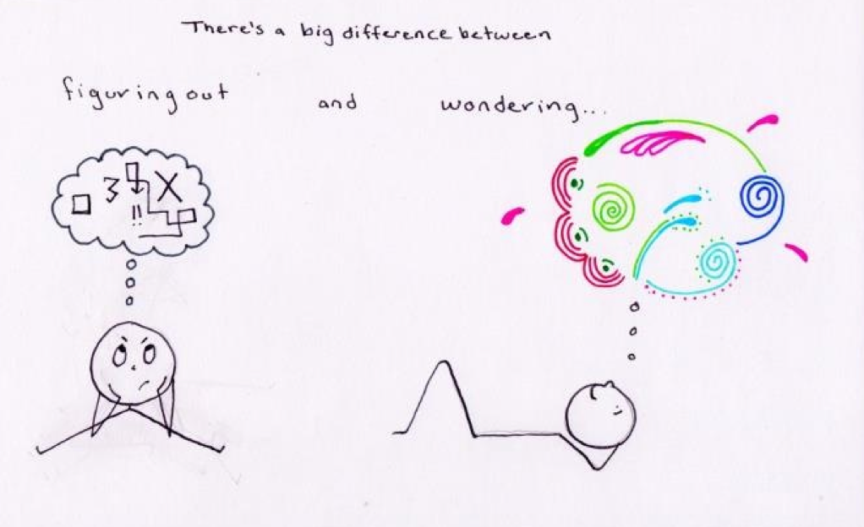

Slide 21
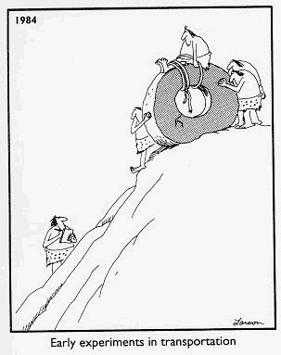

Slide 22
Thinking, thinking thinking
Notes:
Now I’m not by nature a suspicious man, but when I first noticed this I couldn’t help feeling that these three problems are somehow connected. And then it dawned on me…

Slide 23
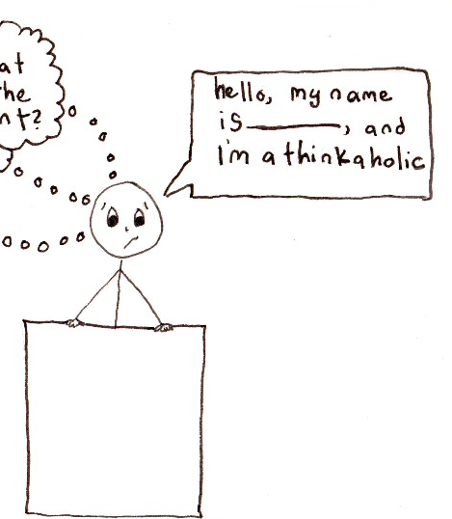
Notes:
I do not wish to alarm you, but I have discovered that in Silicon Valley and the Tech Industry in general, there is an epidemic of THINKAHOLICISM.

Slide 24
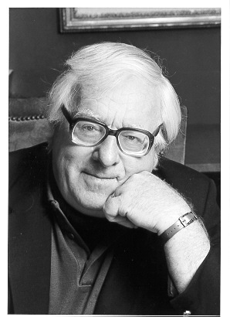
“Don’t think. Thinking is the enemy of creativity. It’s self-conscious, and anything self-conscious is lousy. You can’t try to do things. You simply must do things.”
- Ray Bradbury
Notes:
Ray Bradbury was a brilliant writer noted for his extra-ordinary originality and style. What he had to say about creativity is of particular relevance to any Thinkaholic.
Let me tell you something about the role of thinking in music.
Tell Premik Tubbs and Shambhu story

Slide 25
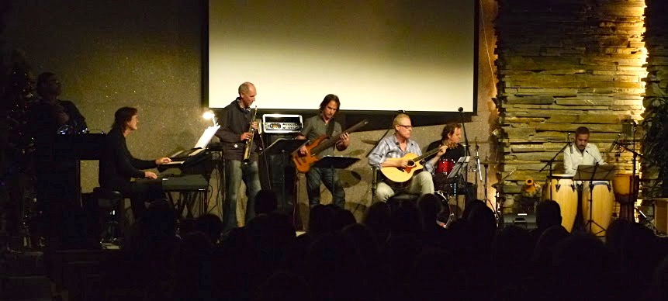
Shambhu

Slide 26
Questions
What induces creative moods for you?
How might meditation make this happen more readily?
Why are so many creative thinkers emotionally unstable?
How might meditation ameliorate that instability?

Slide 27
Artistic temperament sometimes seems a battleground, a dark angel of destruction and a bright angel of creativity, wrestling.
Madeleine L'Engle

Slide 28
The Love Remains

Slide 29
surrender

Slide 31
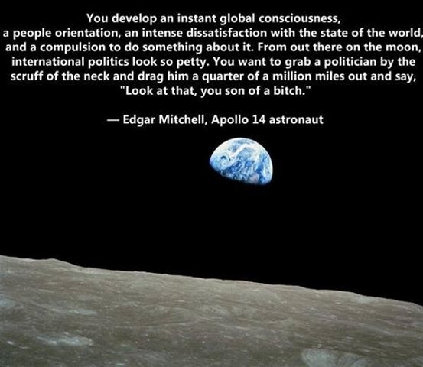

Slide 32
Astaunga Yoga
Asana
Pratyahara
Yama
Dharana
Dhyana
Niyama
Pranayama
Samadhi
Notes:
This morning I was thinking, “how can I get these Googlers with all their PHds and flying cars to understand that they might have a lot to gain from the wisdom of yoga. I mean how can I get them to understand just how relevant it is to them. Thinking thinking thinking, but no solution coming because I’m stuck in my analytical mode, which is blocking my creative problem solving mode.
Then I’m sitting in meditation, and suddenly it hit me. The first limb of yoga is called Yama. It is usually translated as abstinences - stuff you should not do. But it could just as easily translate as.

Slide 33
Wisdom and Higher Intuition
Notes:
I’m not sure how to put this delicately, but I have to ask you, Have you ever wished that your brain worked better? You know, those moments when you send a joke email to friend and then realize you sent it to your boss by mistake. And the subject of the joke was your boss.
Or alternatively, have you ever wished that one of your co-workers’ brains worked better. For example, when you receive from them a wildly inappropriate joke email clearly intended for someone far less mature than yourself.

Slide 34
Yoga Psychology - Layers of Mind
Awareness
Concentration
Wisdom
Creativity & Personality
Memory and Reason
Sensing, Desiring, Acting
Physical Body

Slide 35
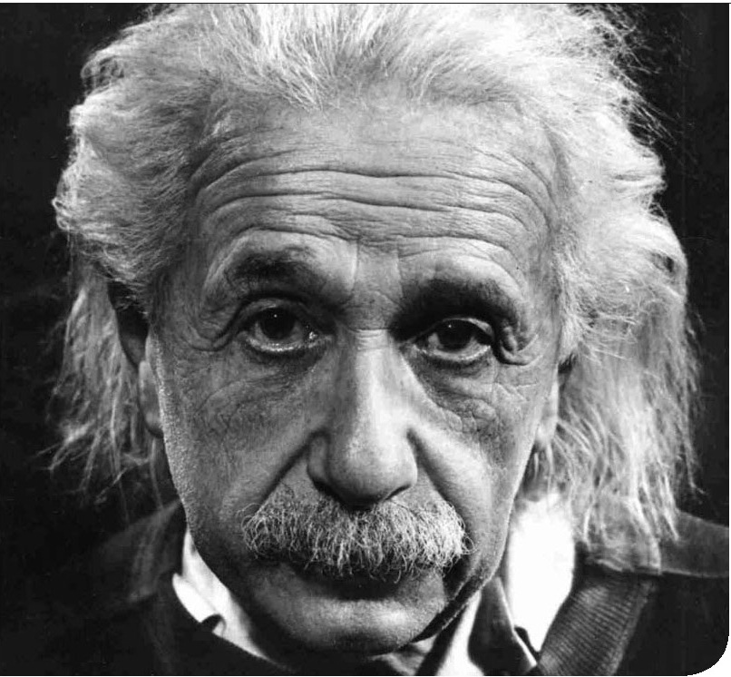
Intuition
“The intuitive mind is a sacred gift and the rational mind is a faithful servant.
We have created a society that honors the servant and has forgotten the gift.”

Slide 36
Concentration

Slide 37
Yoga Psychology - Layers of Mind
Spiritual Meditation
Awareness
Wisdom
Creativity & Personality
Memory and Reason
Sensing, Desiring, Acting
Physical Body

Slide 38
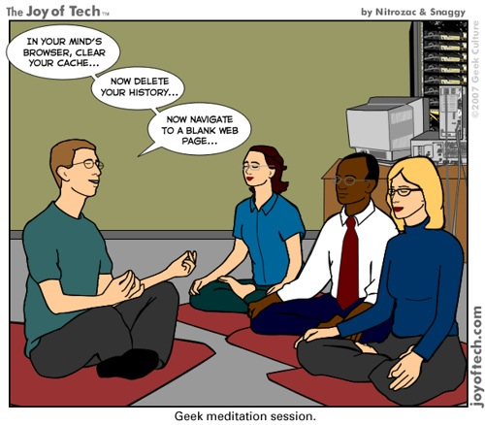
Notes:
You might think that meditation goes something like this.
But actually it is more like this:

Slide 39
Sound affects emotions
Notes:
The other tool we use is sound.
Think of your favorite piece of music. When you get home from work, maybe feeling tired and a little frazzled, you put on your favorite piece of music nice and loud. How quickly does your mood change?
This effect is the basis of the science of Mantra - using particular words to influence and mold our state of mind.

Slide 40
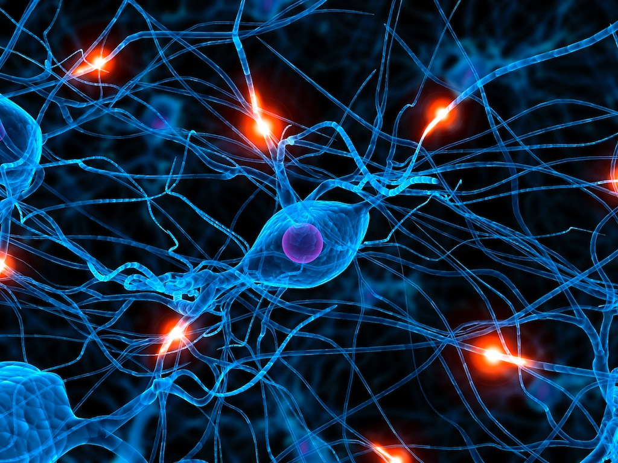
Neuroplasticity
Notes:
Neuroplasticity has replaced the formerly-held theory that the brain is a physiologically static organ, and explores how the brain changes throughout life.
By repeatedly thinking the same thing, you create and build neural pathways, so that your thinking habits are reflected in your brain structure and eventually your personality.
Keep thinking happy thoughts and you become happy.
Keep thinking angry thoughts and you’ll become angry.
Repetition of your thoughts can be pretty powerful. Thoughts behave a lot like water. Water is soft, and will adapt to the shape of its container. But if it flows in the same channel for a long time,

Slide 41
Notes:
Repetition can be pretty powerful. Water is soft, but if it flows in the same channel for a long time, this, can become

Slide 42
Notes:
this.

Slide 43
Mantra
Notes:
Mantra combines sound and the power of positive thinking to free the mind from stress and negativity, and awaken a feeling of connection and love within.
Meditation is as much about emotion as it is about thoughts. And music is the language of emotion.

Slide 44
Baba Nam Kevalam
Love is all there is
Notes:
This is a universal mantra, in the sanskrit language. It means that love is the essence of reality. Kind of optimistic, but hey, where’s the downside?
We’re going to sing it for a few moments, and then use it as a focus for our attention, repeating it in our minds as we go into meditation.
And for your pleasure we have put together a new band. we call ourselves the Dudes.
Please welcome the lead guitarist of our newly formed band, Andrew Sage!
Guided meditation follows.

Slide 45
Intuitional Science
Connect to the source of love
Develop balance and wisdom
Tap into creativity

Slide 46
Next steps…
Read my book
Text me your email at 650 400 6223 get: Slide Set, Guided meditation recording and 5 Creativity Secrets.
Weekend Retreat March 6 - 8, Los Altos Hills. $70 for students.
Ask me questions: dada@TheMonkDude.com

